Slide 1
Smart Parking Solutions
Under the Supervision of Dr. Navneet Yadav
Anmol Deepak (08114802813) Ashutosh Mishra (01714802813) Gaurav Singh (01814802813) Ronak Lalani (00714802813)

Slide 2
Smart Parking Solutions using Digital Image Processing
Software used : MATLAB

Slide 3
Why do we need Smart parking?
To reduce the time spent on finding a parking spot.
To substantially reduce traffic jams which are caused due to vehicles parked on the streets.
To decrease the number of tickets issued for illegal parking.
For efficient usage of limited parking space.
Better revenues generation.

Slide 4
Problem Statement
Driver do not have relevant information before entering.
Sensors not economically feasible.
Time wasted in sailing through the parking space to find a vacant spot
Time wasted standing in the queue while the operator is struggling to generate a receipt/payment issues.

Slide 5
Objective
Capture real time image and detect filled parking locations in the parking lot using image processing
Count and display the number of available slots
Number plate recognition at the entrance
Automated receipt generation
Online payments

Slide 6
Assumptions
This is just a prototype system using Digital Image Processing.
Image captured from smart phone camera (0.5 Megapixels) is used.
The system can be used in daytime only without having a strong shadow.

Slide 7
FLOW CHART
Use the check out time to calculate the net payable amount and debit.
Image Acquisition
Navigating the vehicle to the assigned parking spot
Image Analysis
Identifying Vacant/Filled Spots
Assigning the nearest parking slot to the incoming vehicle + Recording the check in time
Showing the filled and vacant spots on a GUI

Slide 8
Module-1 Flow chart
Live Image input from IP Cameras
Image Analysis
Identifying vacant/Filled spots
Displaying the obtained data on a GUI

Slide 9
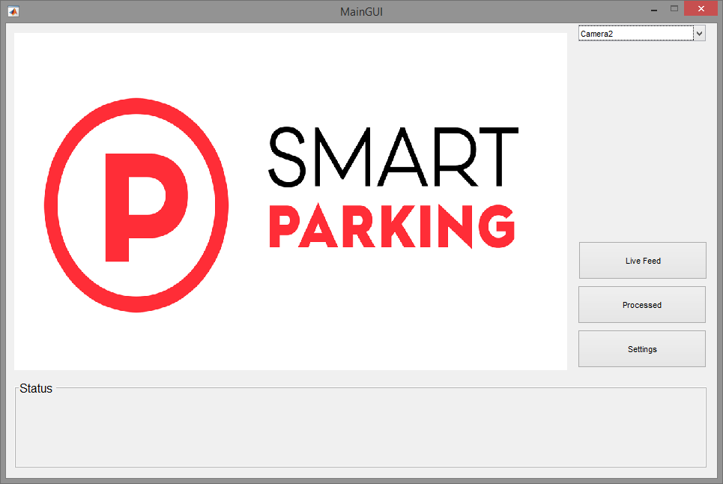
Graphic User Interface (GUI)

Slide 10
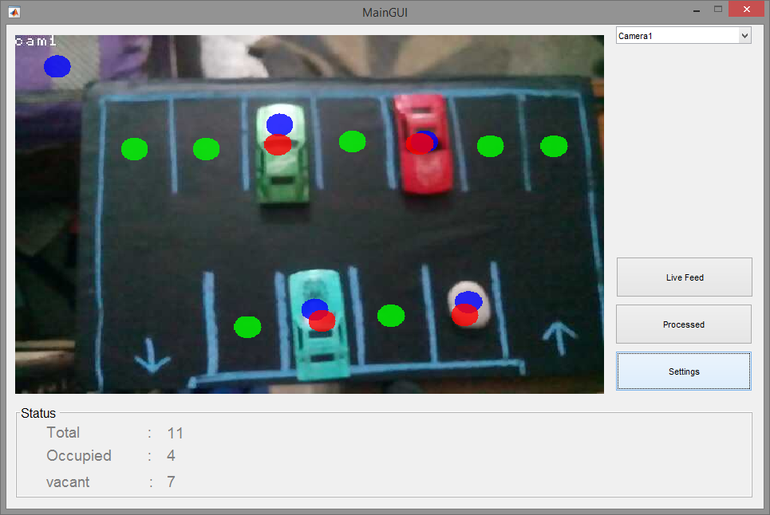
Live Feed

Slide 11
Module-2 Flow chart
Spot assignment through a LED display upon entrance + Navigation to the spot
Vehicle Number recognition (from CCTV installed at the entrance)
User Details: 1. Vehicle Number 2. Check in & out time
1. Parking Duration 2. Charges

Slide 12
Number Plate Recognition
Vehicle Image Captured By Camera
Extraction of Number Plate Location
Segmentation and Recognition of Plate Character
Display Vehicle Number

Slide 13
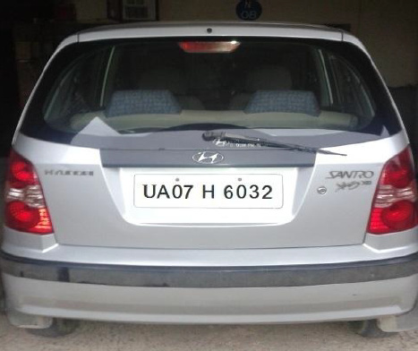

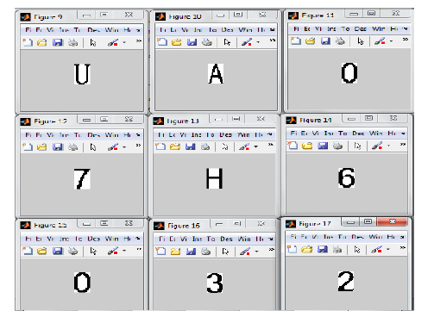
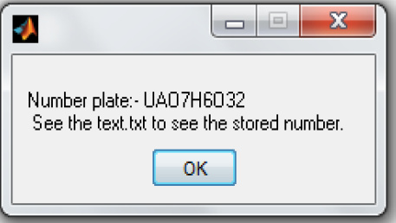
Number Plate Recognition

Slide 14
Databases
Sr. No | Vehicle Number | Type of vehicle | Check- in/out time | Final Amount
1. | DL 3C 1995 | Car | 2017-03-15 16:42/17:58 | 90

Slide 15
Thank You!

